Slide 1
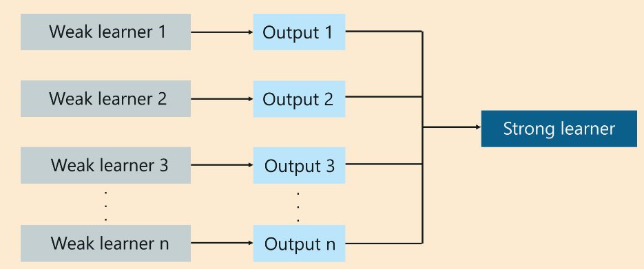
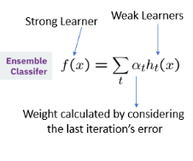
Boosting
It is an ensemble modeling technique that attempts to build a strong classifier from the number of weak classifiers.

Slide 2
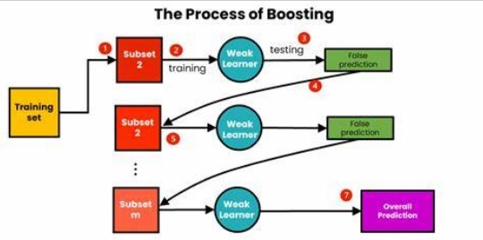
Process of Boosting:

Slide 3
Training of Boosting Model
Initialise the dataset and assign equal weight to each of the data point.
Provide this as input to the model and identify the wrongly classified data points.
Increase the weight of the wrongly classified data points.
if (got required results) Goto step 5 else Goto step 2
End

Slide 4
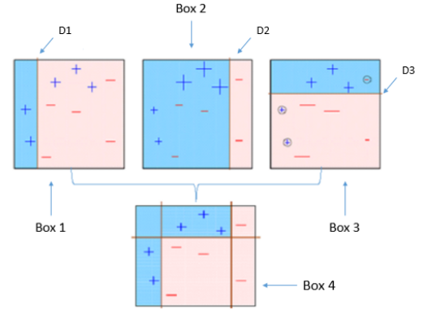
Example:
1. Analyse and draw decision stumps.(Box1 separates + and -)
2.False prediction higher weightage. (It increases + size in Box2, since it predicted incorrectly in Box1)
3.Repeat step 2 until right prediction.(Box4 is separated + and – correctly)

Slide 5
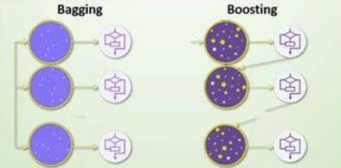
Boosting Vs Bagging:
Bagging: Boosting:
1.Resampling 1.Reweighting
2.Uniform distribution 2.Non-uniform distribution
3.Parallel style 3.Sequential style

Slide 6
Types of Boosting:
Ada Boost
Gradient Boost
XG Boost
Cat Boost
Light GBM/ LG Boost

